Slide 1

CSC 522 – Spring 2020 Automated Learning and Data Analysis
Arrhythmia Prediction and Diagnosis
using Data Analysis
Presented By:
Project Group: P21
Mangalnathan Vijayagopal – mvijaya2
Nishcal Badarinath Kashyap – nkashya
Pawandeep Mendiratta – psmendir
Shreyas Chikkballapur Muralidhara - schikkb

Slide 2
Index:
Introduction and Related Work
Dataset
Pre-Processing
Feature Selection
Support Vector Machine
K – Nearest Neighbors
1D - Convoluted Neural Network
Multi Layer Perceptron
Results
Conclusion
References

Slide 3
Introduction
To detect and predict the type of arrhythmia based on Electrocardiogram (ECG) tool using machine learning models and algorithms.
Related Work
Automated Screening of Arrhythmia Using Wavelet Based Machine Learning Techniques
Machine Intelligent Diagnosis of ECG for Arrhythmia Classification Using DWT, ICA and SVM techniques
An integrated ECG feature extraction scheme using PCA and wavelet transform
Heart rate dynamics distinguish among atrial fibrillation, normal sinus rhythm and sinus rhythm with frequent ectopy

Slide 4
Data Set
http://archive.ics.uci.edu/ml/datasets/Arrhythmia
Arrhythmia Data Set – Referenced from UCI Machine Learning Repository
The data set contains 452 instances with 279 attributes
The data set represents tabular form of ECG data of 452 patients along with patient information
Multivariate dataset with Categorical, Integer and Real Attributes
Class Label values range from 1 to 16 (Types of Arrhythmia)
A train-test split in ratio 70:30 into training and testing data containing 316 and 116 records respectively.
Process Flow
Apply Data Mining Models
SVM
KNN
1D-CNN
MLP
Pre-processing
Feature Selection
Results

Slide 5
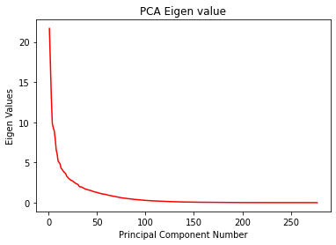
Pre-Processing
Remove Unwanted Columns
Replace Missing Values
Attribute Scaling – Normalize values to the range of 0 to 1
Feature Selection
Principal Component Analysis
Top 88 features were chosen based on PCA output
Random Forest
Top 99 features were chosen based on
Random Forest output

Slide 6
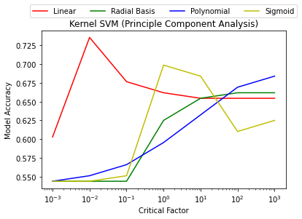
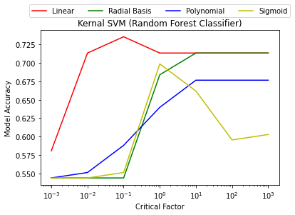
Support Vector Machines
For SVM , we trained the model with different kernel functions: Linear, Polynomial, Gaussian RBF
and Sigmoid kernel function.
Linear Kernel function gave us the best performance of 73.53 %

Slide 7
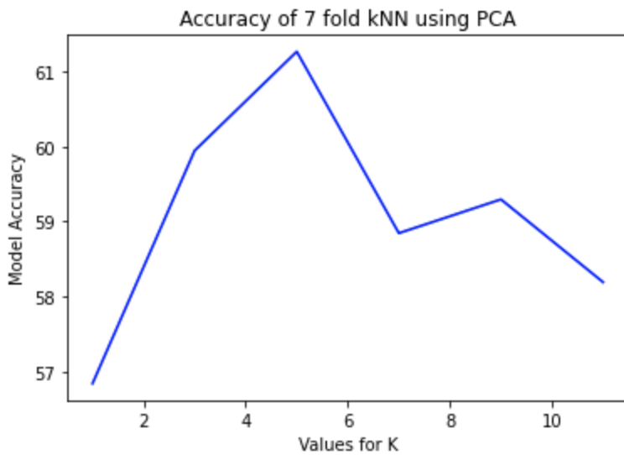
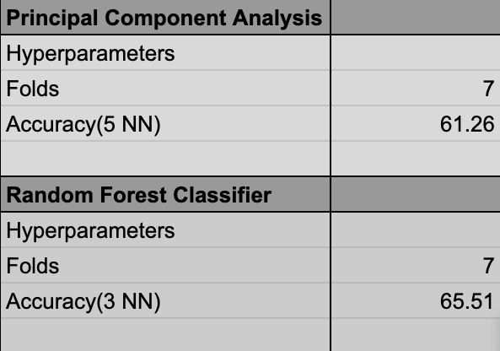
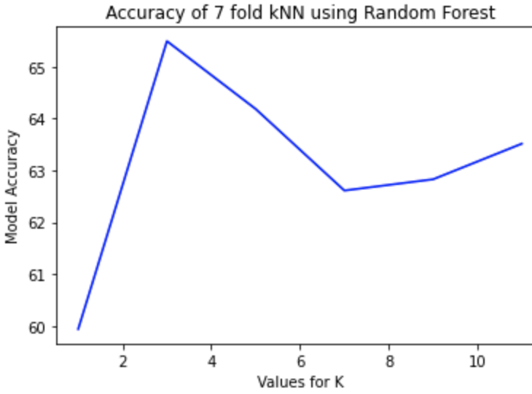
K Fold K Nearest Neighbor

Slide 8
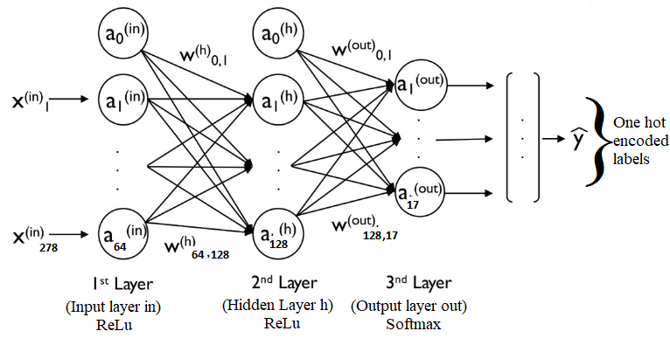
Multi Layer Perceptron - Method
Feed forward Neural network with 2 fully connected layers with ReLU activation. Predictions generated from Final Softmax layer.
Weighted Loss Function for compensating imbalanced class.
Hyper-parameters:
Optimizer – Adam
Learning Rate – 0.01
Batch size – 8
Epoch - 30
Neurons per layer – [64, 128, 17]

Slide 9
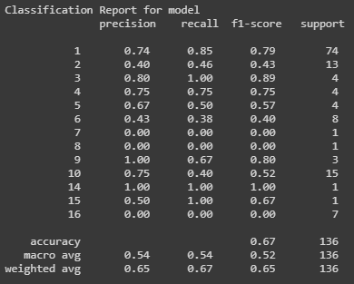
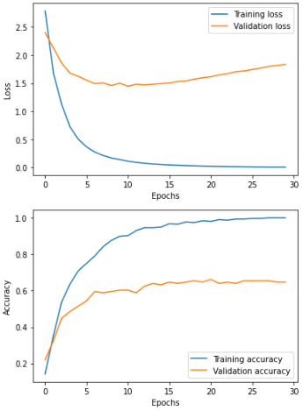
Multi Layer Perceptron - Result
Test Accuracy for model is 66.91%, while the validation accuracy is 68.63%

Slide 10
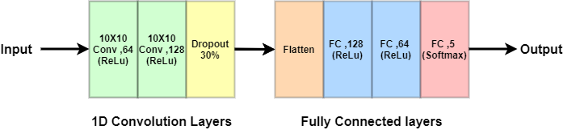
1D – Convolutional Neural Network - Method
Model is divided into 2 blocks
Convolution block – 1D Convolution layers and Dropout.
Fully Connected block – Extract features required for class prediction.
Compiling model with Weighted Loss Function to penalize misclassification of imbalanced classes.
Hyper-parameters:
Optimizer – Adam
Learning Rate – 0.01
Batch size – 16
Epoch - 20

Slide 11
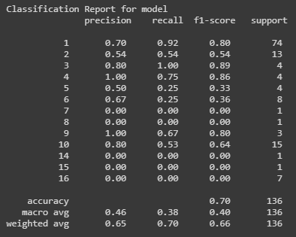
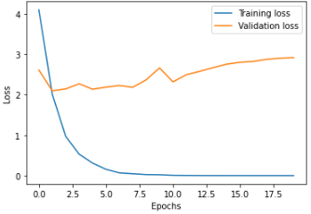
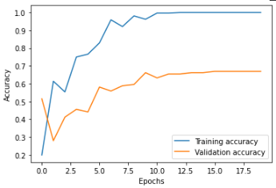
1D – Convolutional Neural Network - Result
Test Accuracy for model is 69.85%, while the validation accuracy is 70.63%

Slide 12
Discussion
For SVM, the data is linearly separated. From our work, we conclude that linear kernel works best for the data set by comparing accuracy scores with other multi-dimensional kernels.
For KNN, this was a novel approach which was not implemented in prior related work.
Random Forest is equally good as PCA for feature selection.
None of the related work referenced has implemented 1D-CNN and MLP.

Slide 13
References
[1] A. Das, F. Catthoor and S. Schaafsma, "Heartbeat Classification in Wearables Using Multi-layer Perceptron and Time-Frequency Joint Distribution of ECG," 2018 IEEE/ACM International Conference on Connected Health: Applications, Systems and Engineering Technologies (CHASE), Washington, DC, USA, 2018, pp. 69-74.\newline
[2] N. Kalkstein, Y. Kinar, M. Na'aman, N. Neumark and P. Akiva, "Using machine learning to detect problems in ECG data collection," 2011 Computing in Cardiology, Hangzhou, 2011, pp. 437-440. \newline
[3]Martis, R.J., Krishnan, M.M.R., Chakraborty, C. et al. Automated Screening of Arrhythmia Using Wavelet Based Machine Learning Techniques. J Med Syst 36, 677–688 (2012). https://doi-org.prox.lib.ncsu.edu/10.1007/s10916-010-9535-7
[4] U. Desai, R. J. Martis, C. G. Nayak, Sarika K. and G. Seshikala, "Machine intelligent diagnosis of ECG for arrhythmia classification using DWT, ICA and SVM techniques," 2015 Annual IEEE India Conference (INDICON), New Delhi, 2015
[5]R. J. Martis, C. Chakraborty and A. K. Ray, "An Integrated ECG Feature Extraction Scheme Using PCA and Wavelet Transform," 2009 Annual IEEE India Conference, Gujarat, 2009, pp. 1-4.

Slide 14
THANK YOU!

